Slide 1
Digital Portfolio
STUDENT NAME:I.DURAI ARASU
REGISTER NO AND NMID:2428F0073,asbruap2428f0073(OR)
DB3DD60CBCB6BA0956541E65CB09134C
DEPARTMENT:BSC CS(AI)
COLLEGE:PPG COLLEGE OF ARTS AND SCIENCE,BHARATHIYAR UNIVERSITY

Slide 2
PROJECT TITLE
Simple Portfolio

Slide 3


AGENDA
Problem Statement
Project Overview
End Users
Tools and Technologies
Portfolio design and Layout
Features and Functionality
Results and Screenshots
Conclusion
3/21/2024 Annual Review

Slide 4

PROBLEM STATEMENT
Existing systems may be outdated or lack key features.
Users struggle to perform specific tasks efficiently.
Lack of centralization or automation in the current process.
Difficulty in accessing or managing data/information.
Need for a scalable, user-friendly solution.

Slide 5

PROJECT OVERVIEW
A brief description of the project and its purpose.
Outline the core objectives and goals.
Type of system or application (e.g., web-based, mobile app, etc.)
Brief mention of the scope and what the system aims to solve.

Slide 6

WHO ARE THE END USERS?
Admins: Manage backend data and users.
Registered Users: Access personalized features.
Guests/Visitors: Browse limited content or features.
Business Stakeholders: Analyze reports or performance metrics.
Developers/Maintainers: Update or scale the system.
-

Slide 7

TOOLS AND TECHNIQUES
*Frontend: HTML, CSS, JavaScript.
*Backend: Node.js, Express, Django, Flask, etc.
*Database: MySQL, PostgreSQL, MongoDB, Firebase, etc.
*Version Control: Git, GitHub/GitLab/Bitbucket.
*Deployment: Netlify, Vercel, AWS, Heroku.
*Others: APIs, Authentication tools (JWT/OAuth), CI/CD tools

Slide 8
POTFOLIO DESIGN AND LAYOUT
*Home Page: Clear call-to-action, introduction, and navigation.
*About Section: Project summary, goals, and technologies used.
*Screenshots/Live Demo: Interactive previews or GIFs of the system.
*Features Section: Detailed explanation of what the system offers.
*Contact Section: Email, LinkedIn, GitHub, or form for contact.
*Responsive Design: Fully mobile and desktop compatible.
8

Slide 9
FEATURES AND FUNCTIONALITY
User authentication and authorization.
Dashboard with real-time data or analytics.
CRUD operations (Create, Read, Update, Delete)
Search and filter functionality.
Notifications (email, SMS, or in-app)
Integration with third-party APIs or services.
Admin panel for data management.
User profile management.
Responsive and intuitive UI/UX.

Slide 10
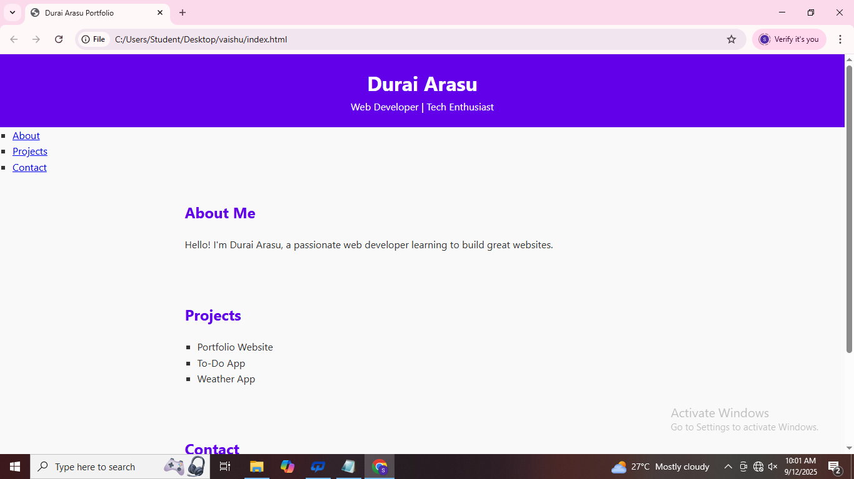

RESULTS AND SCREENSHOTS
3/21/2024 Annual Review
10

Slide 11
CONCLUSION
Summarize the project’s impact and value.
Reflect on development experience or challenges overcome.
Mention any future updates or features planned.
Reaffirm how the project solves the initial problem.
Invite feedback or suggestions (if applicable).
11

